Slide 1
Releasing HybridCache into the Wild with Umbraco
Emma Burstow & Lotte Pitcher

Slide 2


Slide 3


I'm Lotte
Long-time Umbraco community contributor, now member of the DevRel team at Umbraco. Microsoft MVP, OSS advocate, ukulele strummer and padel improver.

Slide 4

I'm Emma
I lead the Developer Relations team here at Umbraco. I'm a Microsoft MVP and I use the little bit of free time that I have playing video games and winter bathing.

Slide 5
What is Umbraco?
.NET and Umbraco's release cadence
Our implementation of HybridCache
Agenda
Benefits of being so closely aligned
Challenges of being so closely aligned
Into the future!

Slide 6
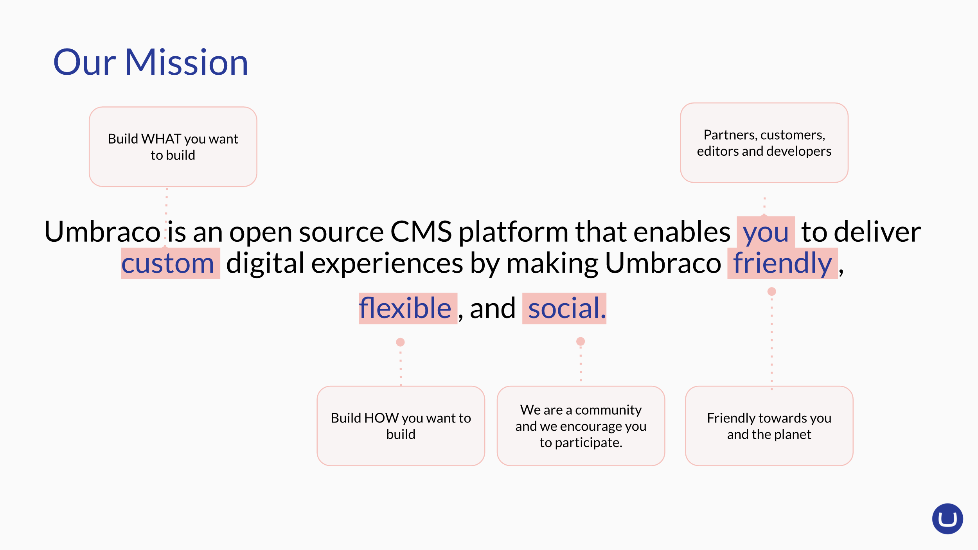

Slide 7
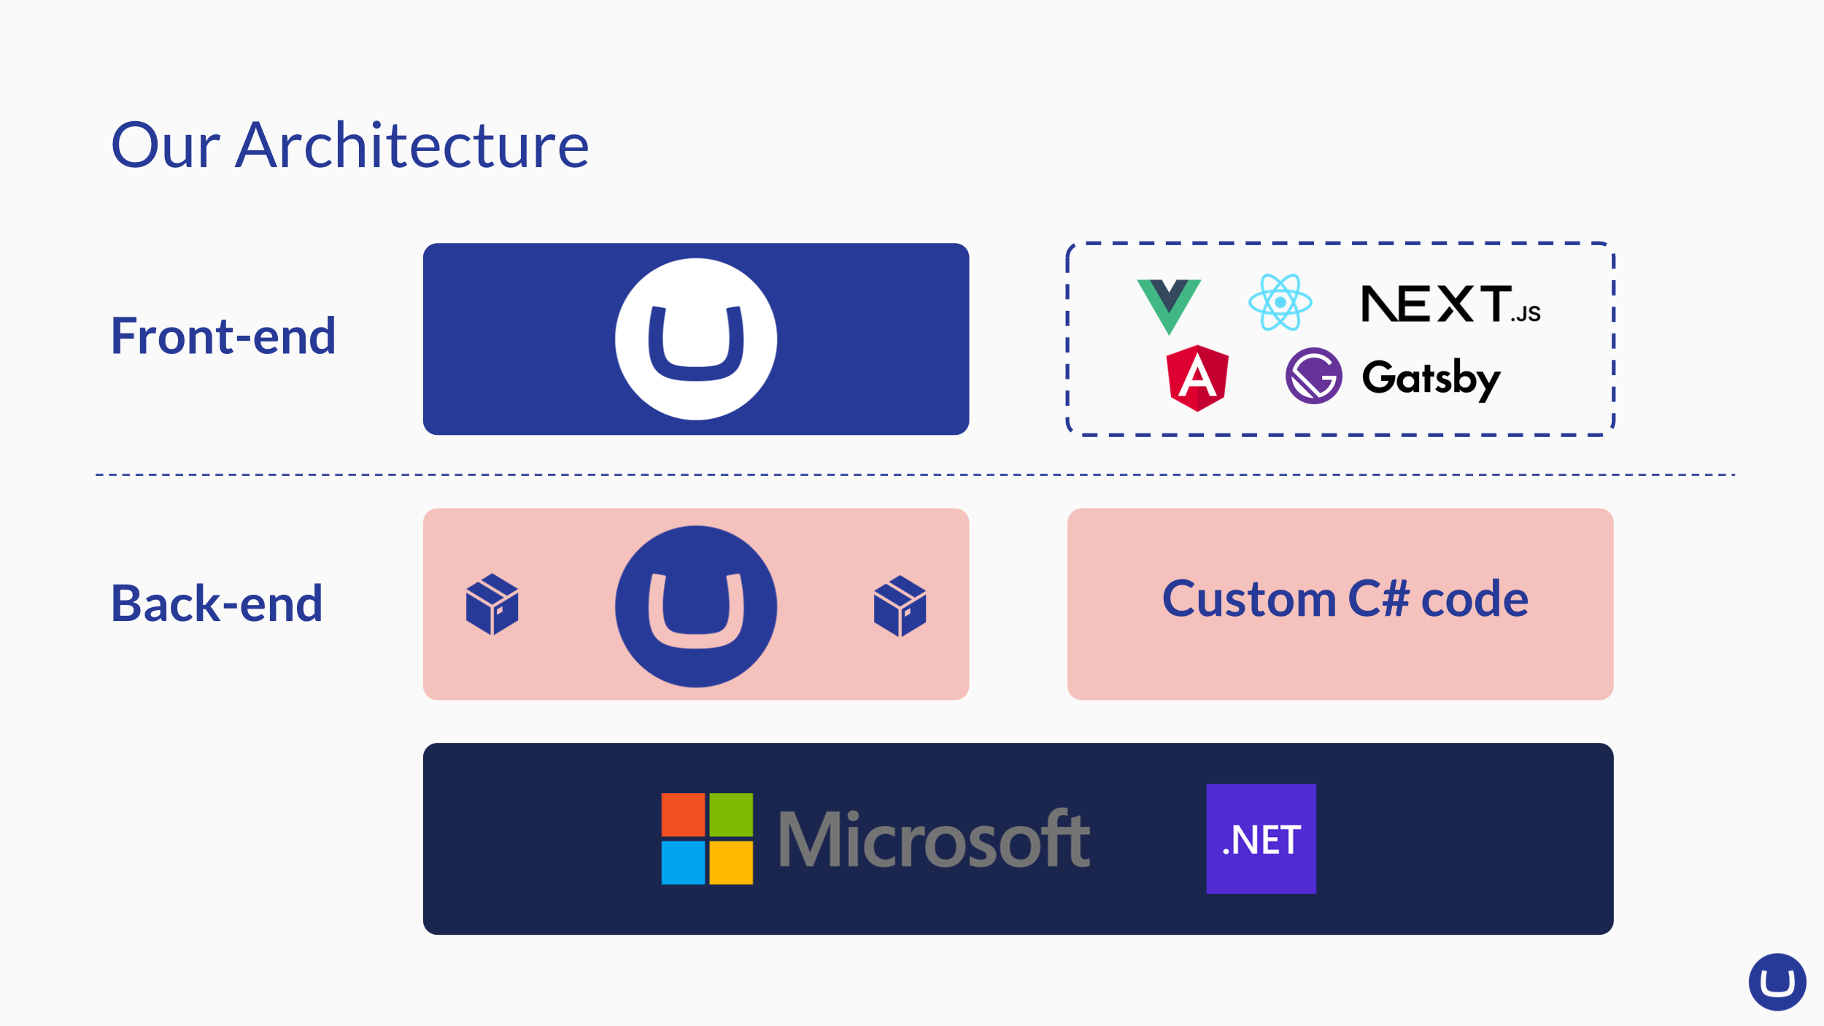

Slide 8
Umbraco 9
Launched September 2021
From .NET Framework to .NET Core

Slide 9

And it went great!
Over 1326 community contributions
Mega-fast adoption
Folks familiar with .NET Framework were happy to get on and work with .NET Core

Slide 10
Release cadence
.NET
 | Nov 2023 |  |  |  | Nov 2024 |  |  |  | Nov 2025
.NET 8
LTS
.NET 9
STS
.NET 10

Slide 11
Release cadence
.NET & Umbraco
 | Nov 2023 |  |  |  | Nov 2024 |  |  |  | Nov 2025
.NET 8
Umbraco 13 .NET 8
Umbraco 14
LTS
.NET 9
STS
Umbraco 15 .NET 9
Umbraco 16
LTS
.NET 10
STS
U 17 .NET 10

Slide 12
Pros
Of being a trailblazer

Slide 13
.NET 9 gives us access to cool features *
01
02
03
Hybrid caching
MapStaticAssets
C#13
* and the other 5 million .NET devs

Slide 14
HybridCache
Why we need it
The approach we take towards caching is incredibly important in any CMS, especially for scalability and performance.
Umbraco found its way across the years but as we grow, and our clients grow, our developer ecosystem demanded better solutions for distributed caching.

Slide 15
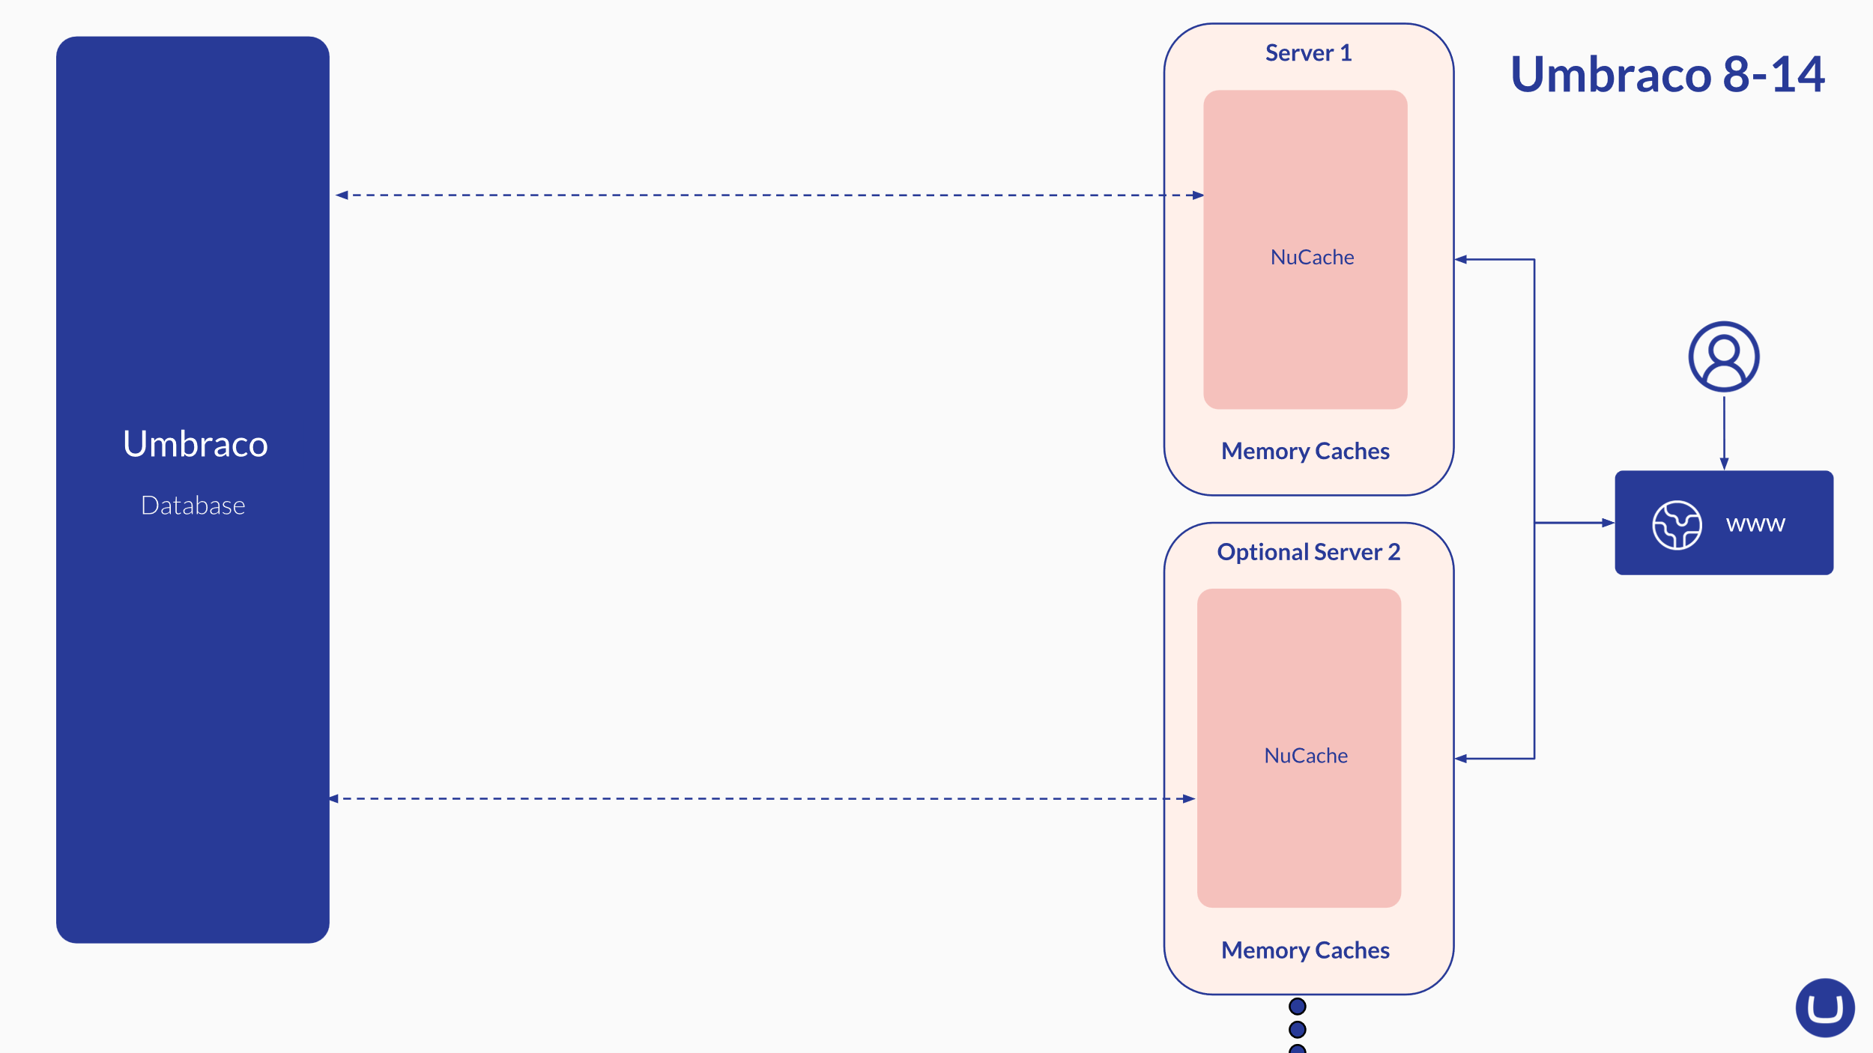

Slide 16
A brilliant bit of timing
We knew that NuCache needed replacing, so had been planning our build own custom solution for a 'hybrid cache'.
That was until we learned about .NET 9's HybridCache...

Slide 17
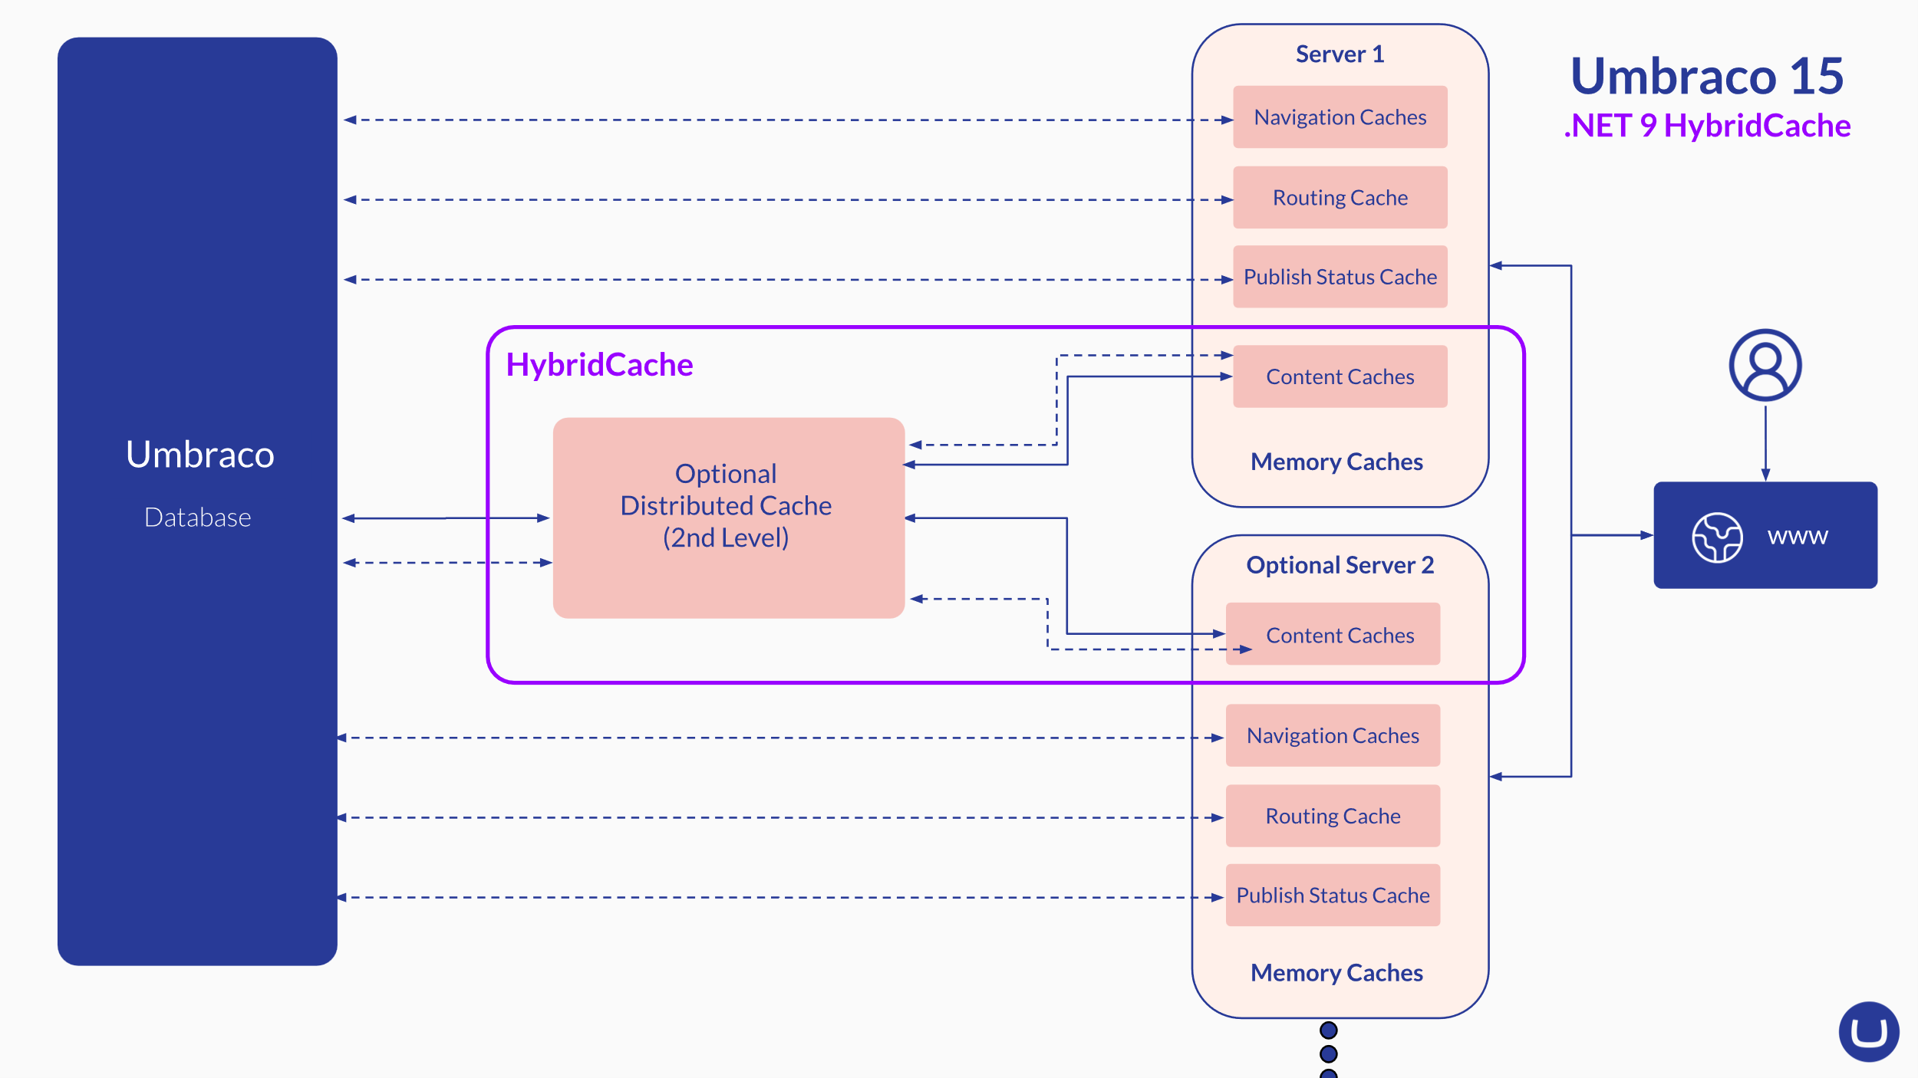

Slide 18

Demo: Our implementation
Let's see it in action

Slide 19
Benefits from HybridCache
Single interface for both in-process and out-of-process caching
Stampede protection
Streamlined configuration

Slide 20
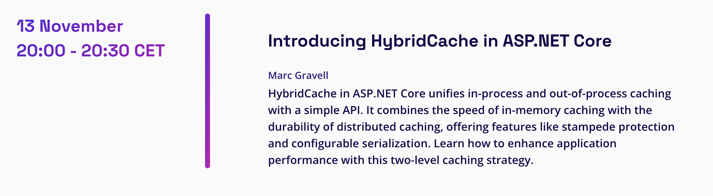
SCREENSHOT OF TALK
Single interface for both in-process and out-of-process caching
Stampede protection
Streamlined configuration

Slide 21
Challenges
Of being so fast

Slide 22
.NET releases and their amazing docs
Wow, the folks at Microsoft do great documentation but this means that when you're keeping a close look at it, you can get very excited about things that don't exist yet.

Slide 23
It is a gamble!
We built on top of a public preview and we do that knowing that the feature isn't quite ready but we trust Microsoft enough to do that and so far, it has worked in our favour.

Slide 24
Azure region release schedule
Umbraco Cloud, our SaaS product, may not have Umbraco 15 available to everyone on launch.
.NET 9 rolls out to Azure regions "sometime" between 12th and 14th.

Slide 25
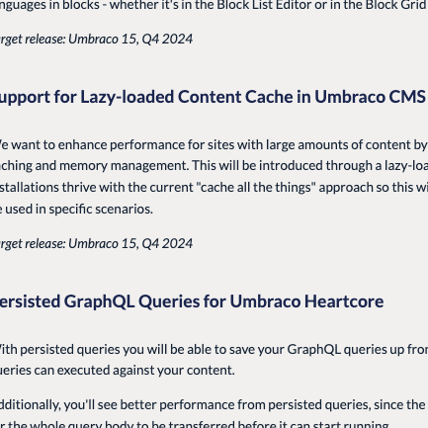
But it's worth it!
We just know that it's worth building on top of .NET releases because even if we don't get to use all the cool, new features we have the best shot at it because of our alignment. And we enable our users to use all the powers. Our roadmap can be super ambitious because we are standing on the shoulders of giants.
Bjarke Berg – Head of CMS

Slide 26
Into the future

Slide 27


Slide 28



Find out more
https://umbra.co/dotnetconf
https://www.linkedin.com/in/emma-burstow/
https://www.linkedin.com/in/lottepitcher/

Slide 29
Thank you

